Slide 1
SocioScope - Final Presentation
Ofir Fichman, Pavel Fadeev, Israel Peled

Slide 2
Project Motivation & Definition
The Problem: Existing ABSA models are optimized for product reviews and fail to interpret abstract socio-economic discourse.
The Solution: A high-fidelity synthetic pipeline (Llama 3.2) utilizing Negative Sampling to master noise filtration.
The Goal: To build a specialized model capable of disentangling complex, multi-faceted public sentiment.

Slide 3
Data Generation Pipeline
1. Defined the target sentiment vector (e.g., Taxation: -1) before generation to ensure 100% label accuracy.
Integrated 7 Personas (e.g., "Struggling Student") and 6 Writing Styles (e.g., Sarcastic, Formal) to prevent linguistic repetition.
Constructed complex prompts that enforce the specific sentiment constraints while adopting the assigned persona.
Generated 10,000 unique samples using Llama 3.2, strictly adhering to the pre-defined sentiment logic.

Slide 4
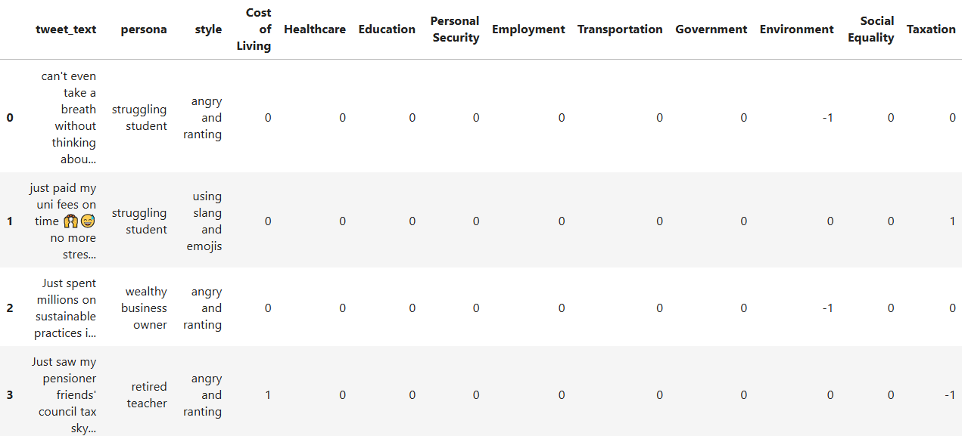
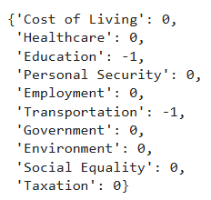
Sentiment Vector
Data Generation Pipeline
Synthetic Dataset
Prompt Engineering

Slide 5
Project Achievements & Novelty
GenAI Data Pipeline: Developed a "Ground-Truth First" pipeline using Llama 3.2 to generate 10,000+ tweets with 100% label accuracy, simulating realistic discourse via 7 personas and 6 writing styles.
Domain Adaptation: Applied Aspect-Based Sentiment Analysis (ABSA) to complex socio-economic domains like Taxation and Security, moving beyond standard product review datasets.
Robust Architecture: Implemented a multi-aspect, 3-class system that treats "Not Mentioned" as a learned feature, enabling precise noise filtering and independent evaluation of topics within a single tweet.

Slide 6
Review Methodology
Created 10,000 samples via Llama 3.2, applying rigorous EDA to prune logical inconsistencies between text and labels.
Transitioned to a Sentence-Pair format ([Text + Aspect]), utilizing DeBERTa-v3’s attention mechanism to specifically target relevant aspects.
Countered synthetic overfitting by moving to Step-Based Evaluation (every 500 steps) with aggressive Early Stopping.
Moved beyond Accuracy to Macro F1-Score and ROC AUC to ensure performance on minority classes.

Slide 7
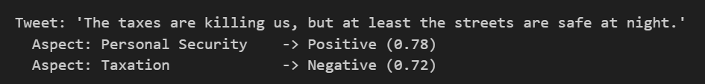
Example of output

Slide 8
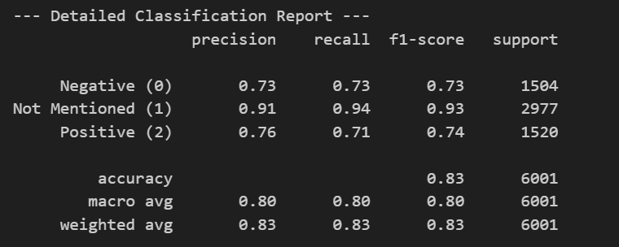
Results: DeBERTa Model

Slide 9
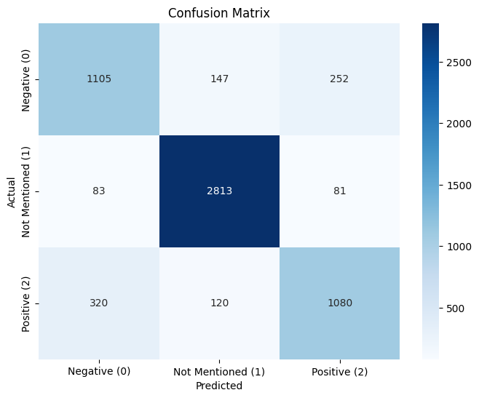
Results: DeBERTa Model

Slide 10
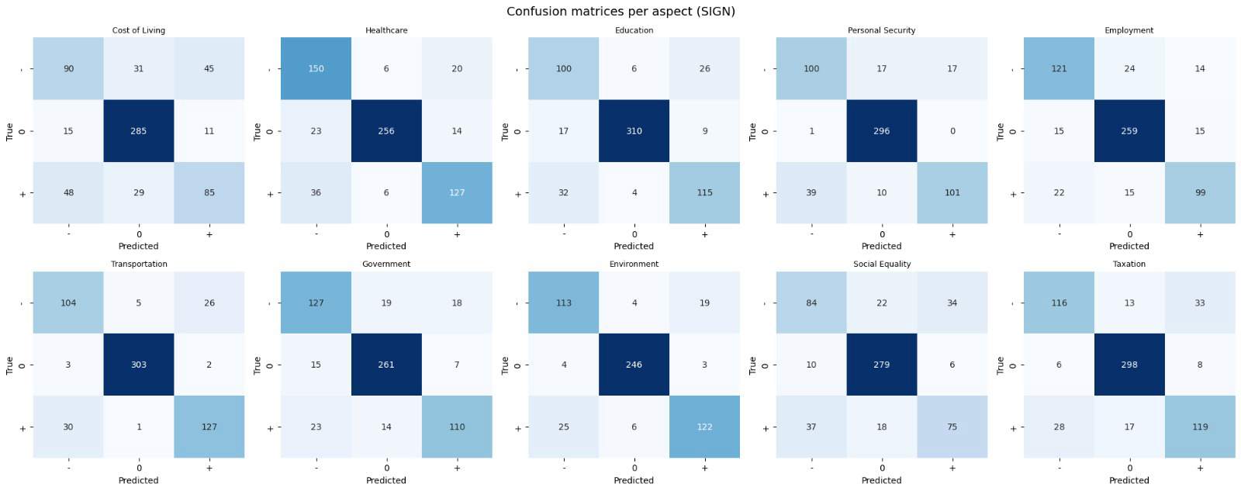

Slide 11
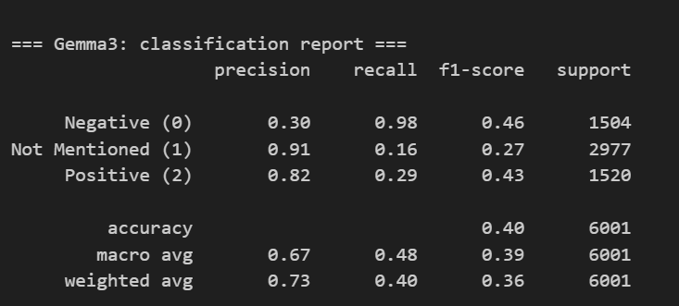
Results: Gemma3

Slide 12
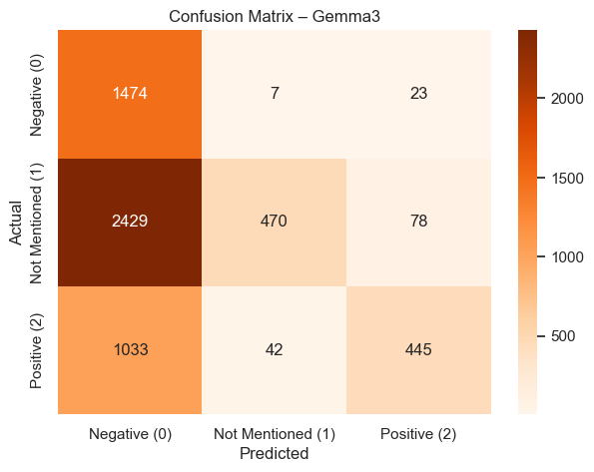
Results: Gemma3

Slide 13
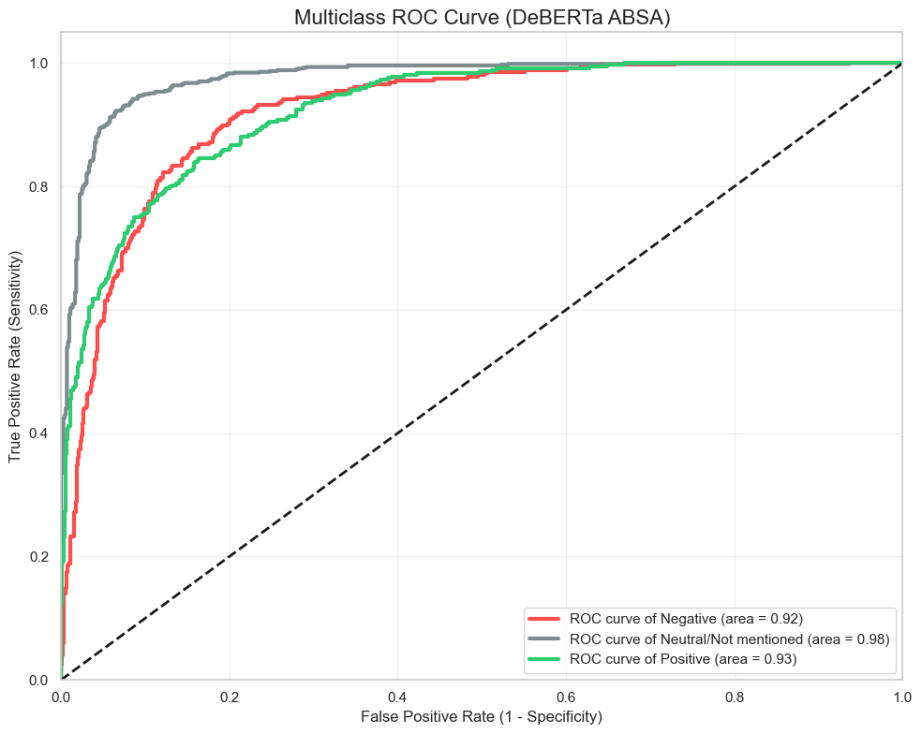
ROC Curve

Slide 14
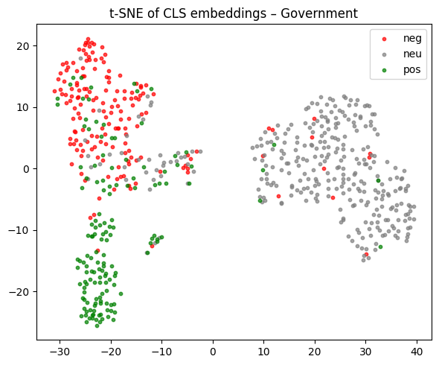
Results:

Slide 15
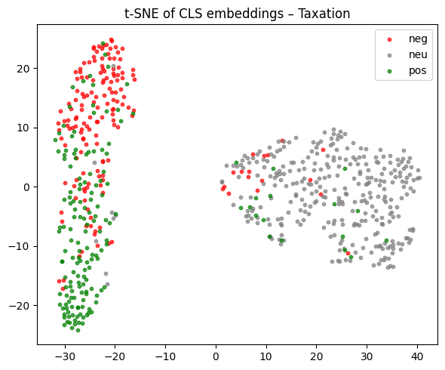
Results:

Slide 16
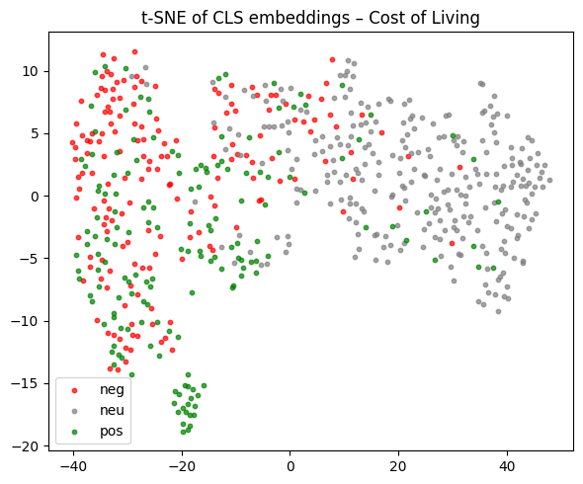

Slide 17
Conclusions & Future Work
Successfully delivered a robust Socio-Economic ABSA model achieving >0.92 AUC for sentiment and 0.98 AUC for noise filtering.
Overcame synthetic data overfitting and the sparse-data challenge by implementing aggressive regularization (Weight Decay 0.1) and treating "Not Mentioned" as an active learned class via Negative Sampling.
Plans to expand the pipeline to multi-lingual support (Hebrew) and deploy the model on live Twitter streams to validate performance against real-world human slang and evolving trends.

